Slide 1
Azure Subscription Vending and Onboarding Process Design

Slide 2
Team members :
o.No Name ID number
1 Nimmala Mounika 2400032180
2 Tirunagari Sai Tejaswi 2400032183
3 Bandaru Sai Srija Anuhya 2400032184
4 Veluguri Sri Vidhya 2400032228 (Team Lead)

Slide 3
Introduction :
Azure Subscription Vending is an automated process for creating and configuring Azure subscriptions.
It provides a standardized way to onboard users/projects.
It reduces manual configuration and deployment time.
It improves security and governance.

Slide 4
Problem Statement :
Manual subscription creation takes time.
Different teams may configure subscriptions differently.
Security and governance policies can be missed.
Resource access management becomes difficult.
Organizations need a consistent onboarding process.

Slide 5
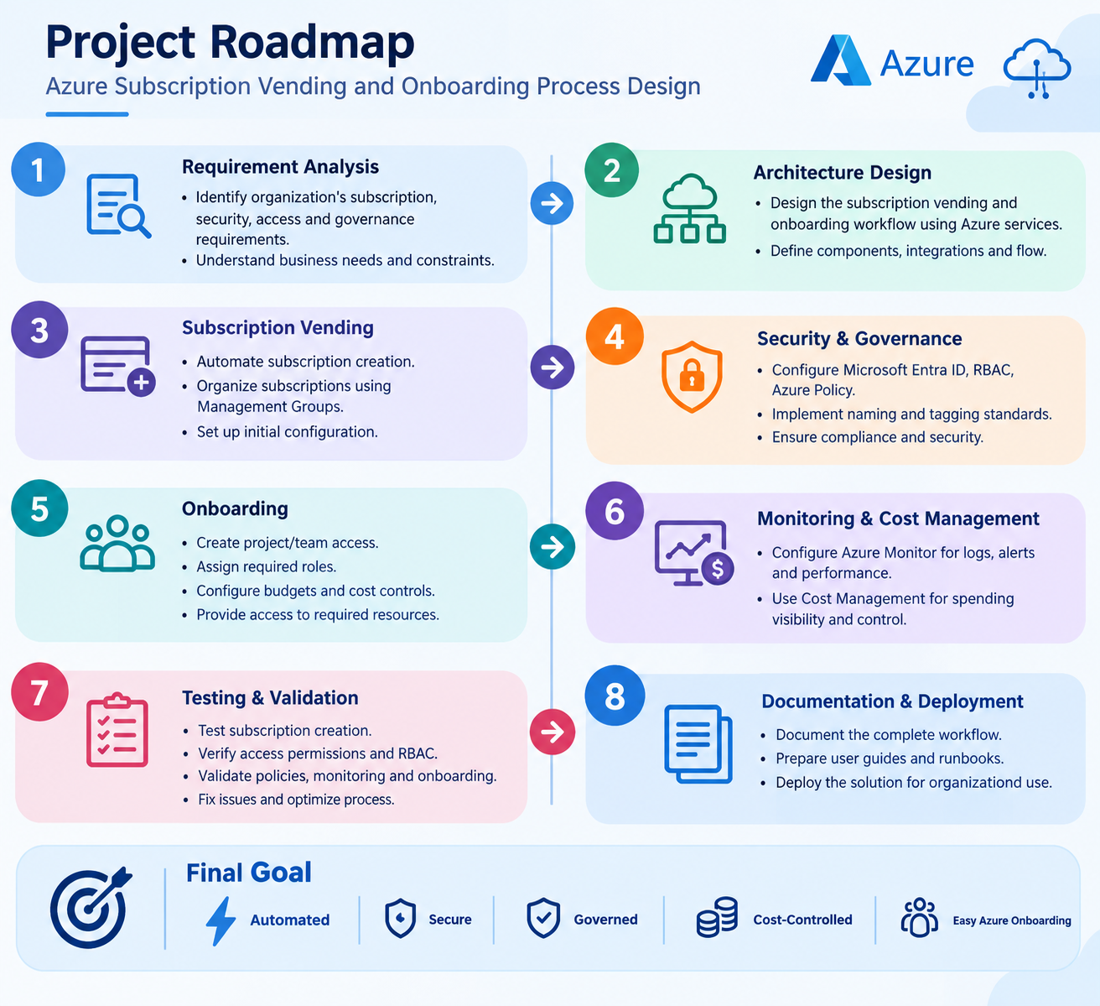
t

Slide 6
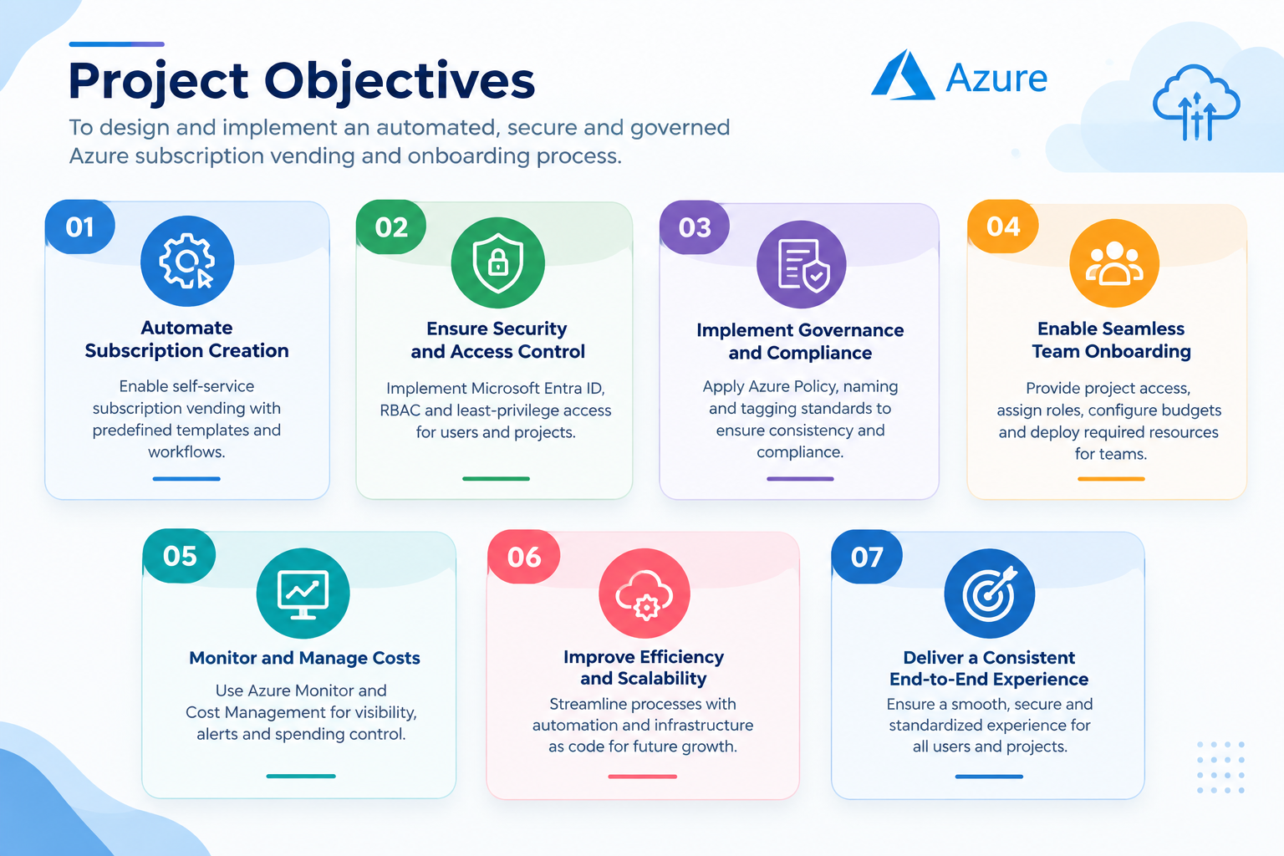

Slide 7
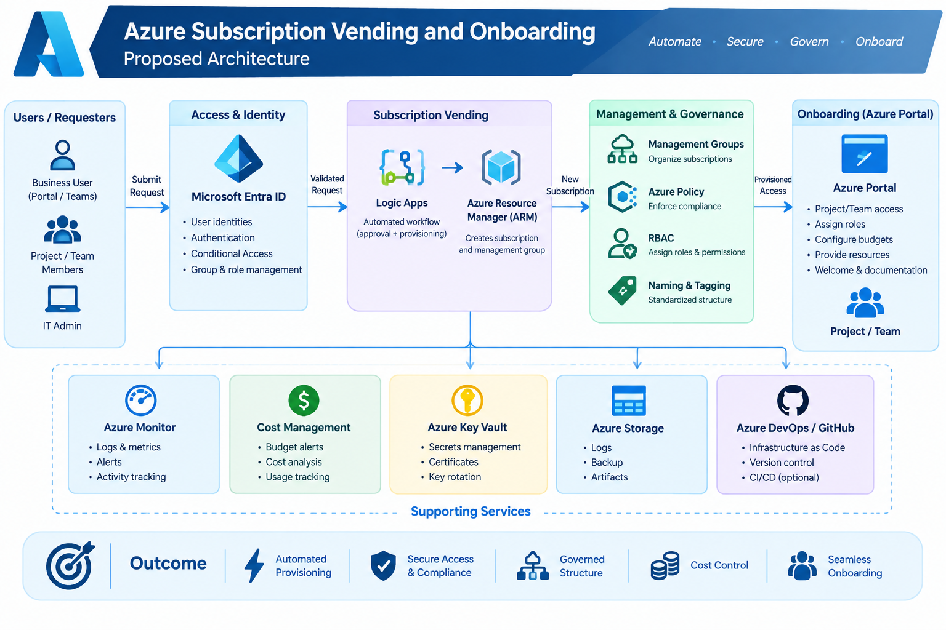

Slide 8
Subscription Vending Process
User submits subscription request.
Request is validated.
Approval is obtained.
Azure subscription is created.
Subscription is placed under the required Management Group.
Policies are applied.
RBAC roles are assigned.
Subscription is handed over to the project team.

Slide 9
Onboarding Process
Create/identify project team.
Assign required Azure roles.
Configure naming and tagging standards.
Apply security policies.
Set budgets and cost controls.
Provide access to required resources.
Complete onboarding verification.

Slide 10
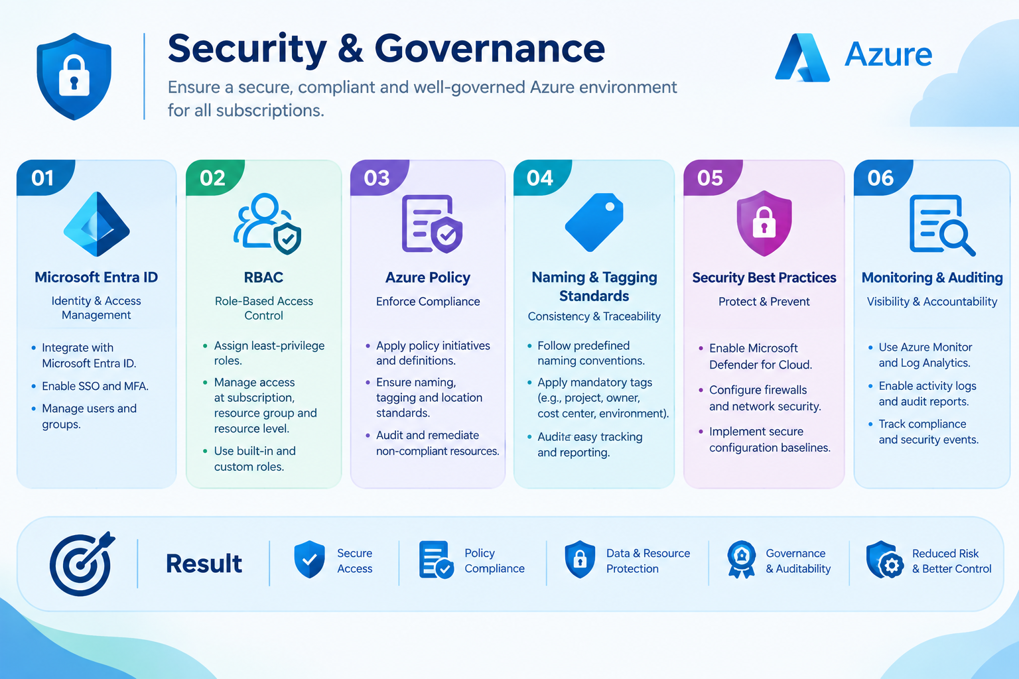

Slide 11
Benefits
Faster subscription provisioning
Reduced manual work
Consistent configuration
Better security
Improved governance
Cost visibility
Easier management of multiple projects

Slide 12
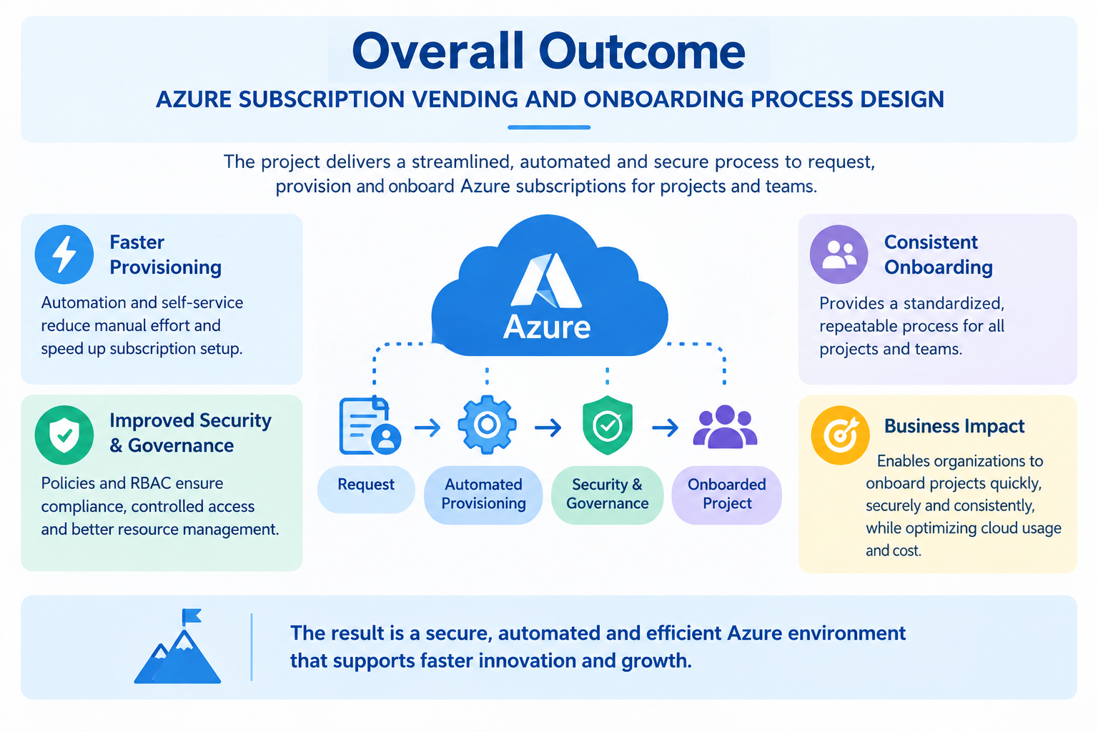

Slide 13
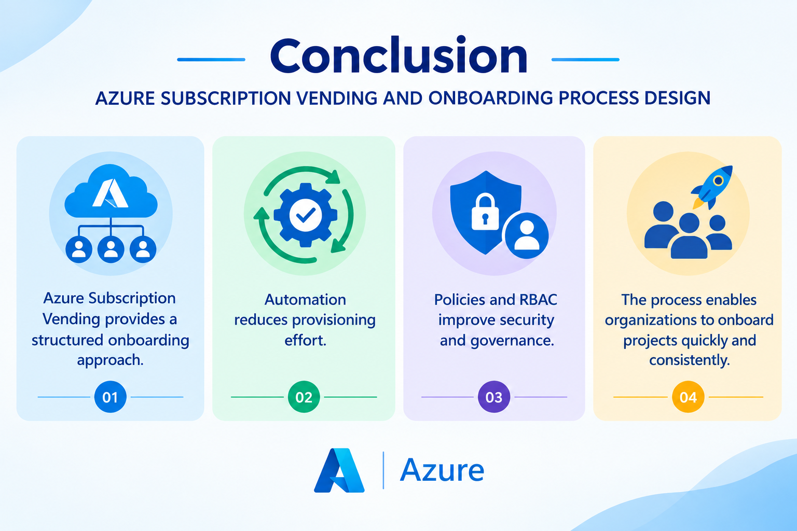

Slide 14
Thank you

